Slide 1
Generation and Refinement of Spherical Volumetric Shell Domains for FEA and IGA applications
Sotiris Gkoulimaris

Slide 2
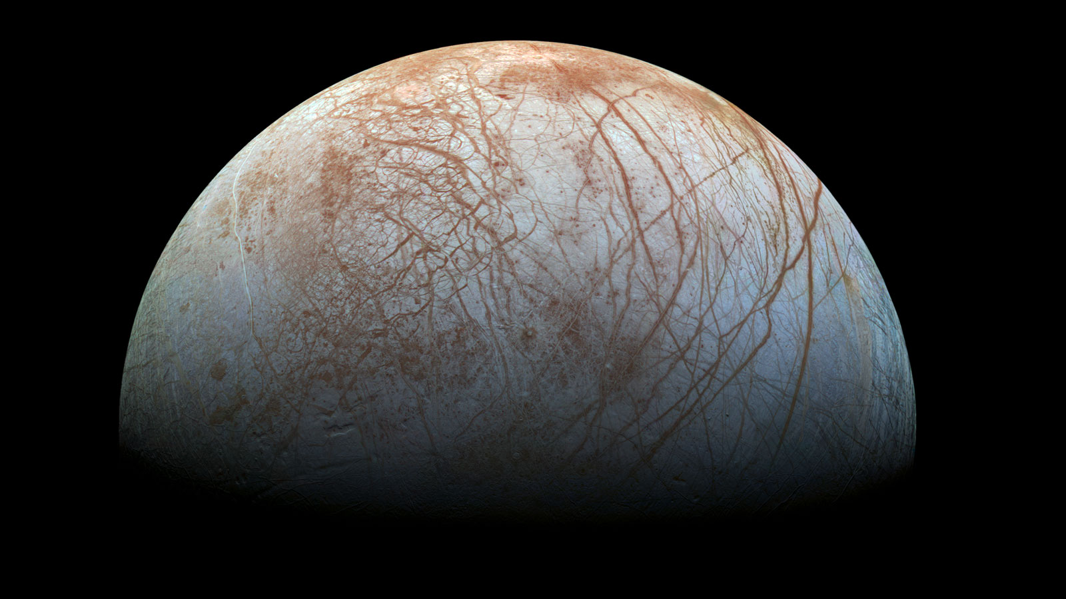
Europa
Radius: 1561 km
Surface Area: 306’000 square km
Water layers: 120 km
Brittle Ice
Convecting Ice
Liquid Water
Ice Shell: 0.1 -> 30 km
Surface Features: 0.1 -> 10x km in width

Slide 3
Representing a Spherical Shell in CAD
B-Splines
A generalization of the Bezier Curve. A Spline function of given degree can be expressed as a linear combination of B-splines of that degree.
NURBS Entities
Constructed from B-Splines:
Define a knot vector (set of parametric space coordinate values)
Set a polynomial degree p
With a given knot vector and p we can define a set of B-Spline basis functions
Computed recursively using the Cox-De Boor algorithm.
Together with a set of control points P we construct a piecewise-polynomial B-Spline curve.
We can also construct higher dimensional entities like surfaces and volumes
We need a number of knot vectors equal to the dimensions of the entity.
2 for surfaces, 3 for volumes
NURBS expands B-Splines by creating a rational basis function by assigning a weight w to each control point.
To define a spherical volumetric shell, we need 3 NURBS curves, 2 to create a sphere and the last to make it a shell.

Slide 4
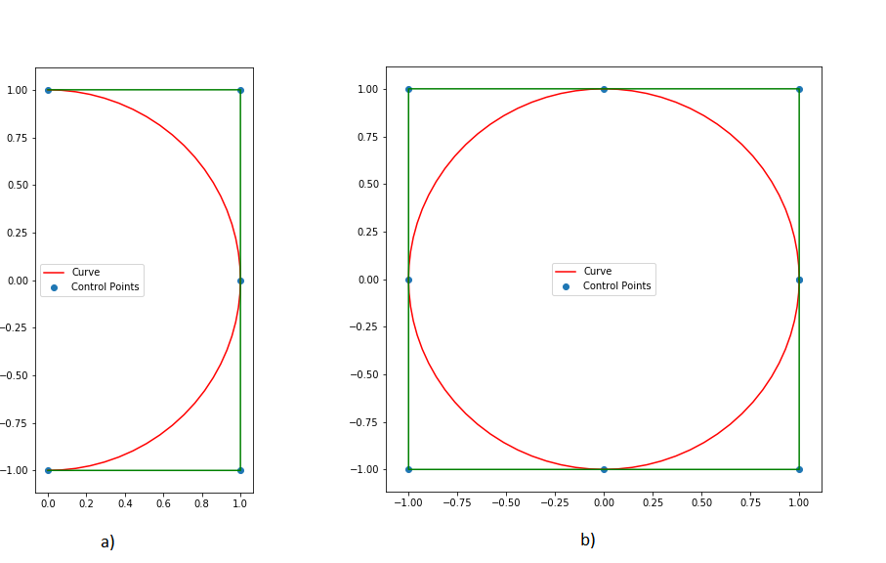
Representing a Spherical Shell in CAD
Required parametric curves:
Half-Circle (degree 2)
Full-Circle (degree 2)
Shell Radius (degree 1)

Slide 5
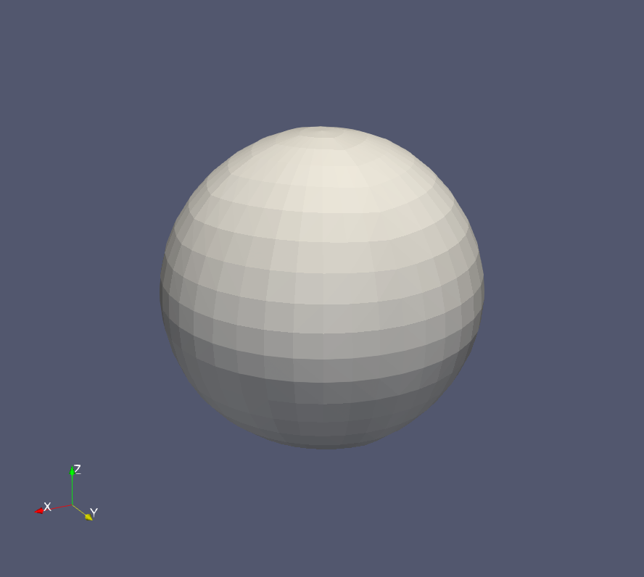
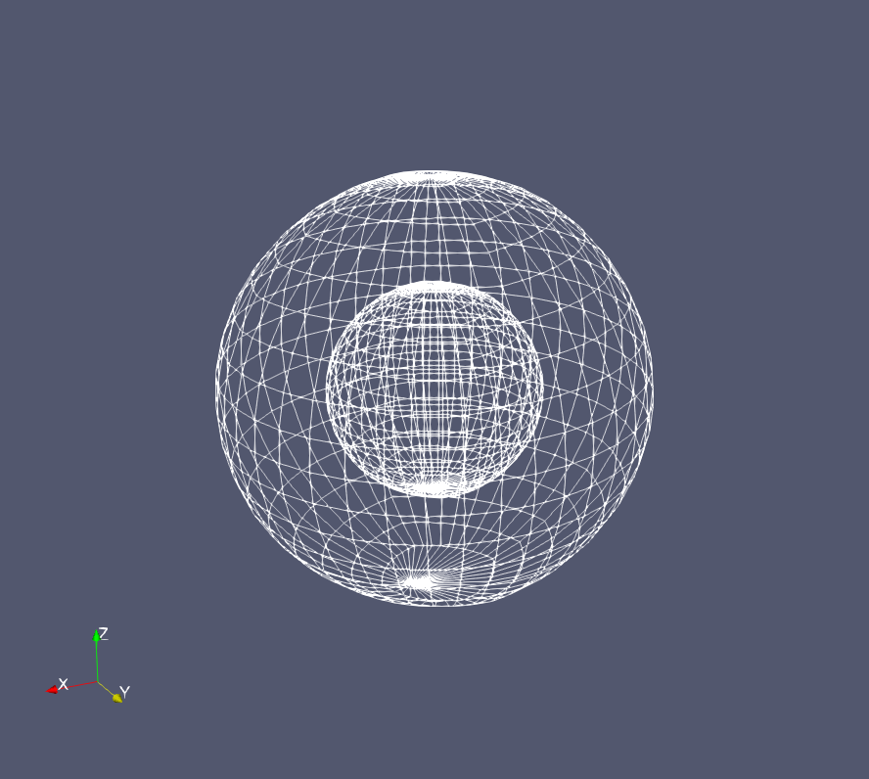
Representing a Spherical Shell in CAD

Slide 6
Limitations of Existing Implementations
Most common limitations observed:
No direct support for NURBS volumes
Limitations of Blender:
Does not expose its Spline primitives
Limitations of Rhino:
Limited implementation of local refinement technologies like T-Splines
A custom tool would be desirable.

Slide 7
Implementation
It is written in C++
Following the principles of Abstract Class Design (Object Oriented Factory)
Added functionality for Derived Classes:
Generators (constructors),
Operators (e.g. Refinement)
Samplers
The tool constructs NURBS volumes
By expanding on existing literature (NURBS Book).
Implements Global Refinement with Knot Insertion
Implements Local Refinement with S-Splines
Not a library. Only basic NURBS functionality is implemented

Slide 8
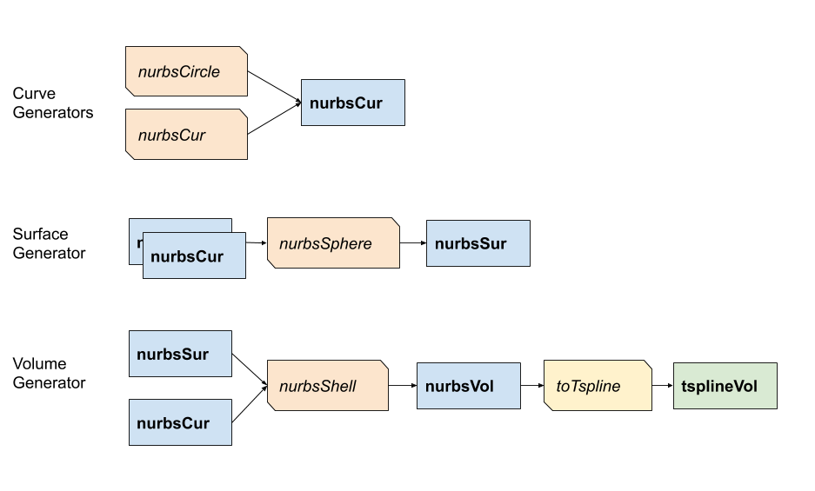
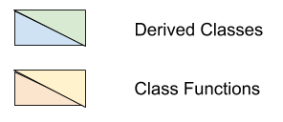
Implementation
Curves
Surfaces
Volumes

Slide 9
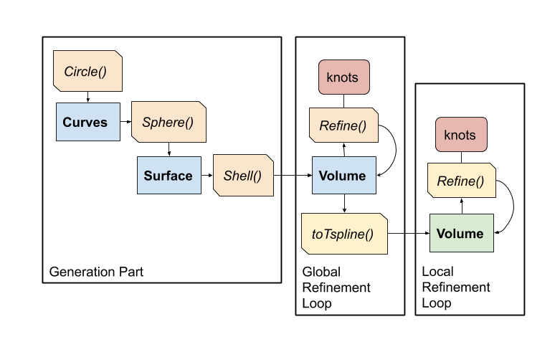
Implementation

Slide 10
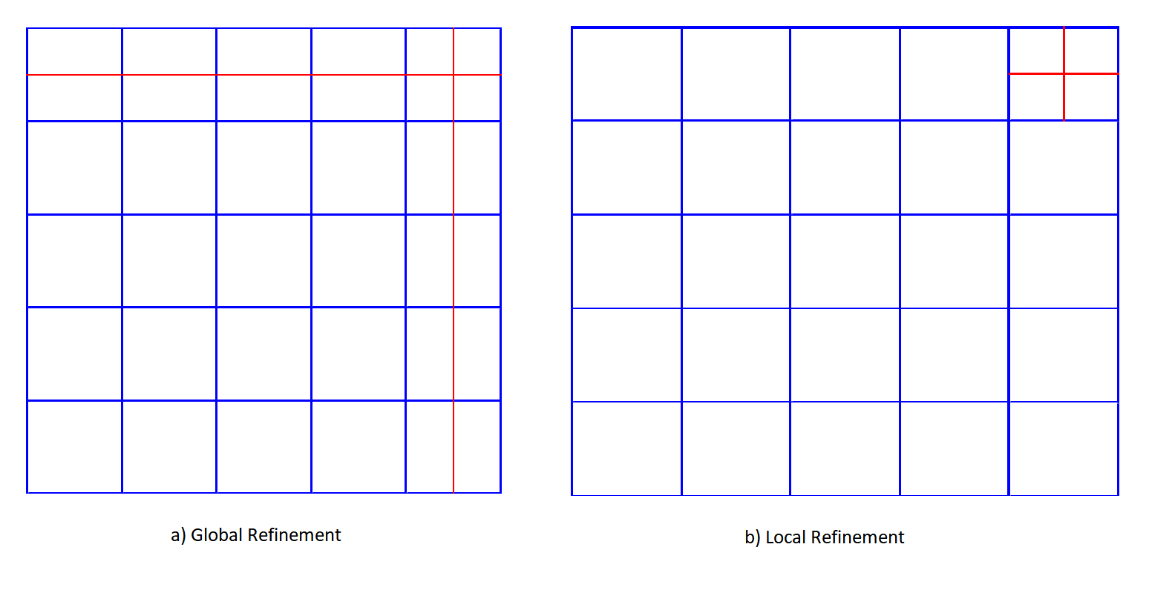
Global and Local Refinement

Slide 11
Global and Local Refinement
T Spline
Non-uniform (rational) B-splines with T-junctions. Locally Refinable. Control points are added without propagating to other parametric directions.
Using knot insertion for Global Refinement.
It is the analog of h-refinement in FEA. Given new knots it constructs a new knot vector that contains the new knots and adds new control points accordingly.
The geometry is left intact!
S-Splines for Local Refinement.
A flavour of T-Splines
Requires a shift from global to local perspective:
Define a local knot vector for every basis function
Use the local knot vectors corresponding to each point in the control to form a blending function.
S-Splines add a scalar in the definition of the blending function:
It ensures partition of unity for the rational case.
Is computed by the refinement algorithm. (Every control point has an initial value of 1)
Implemented for volumes

Slide 12
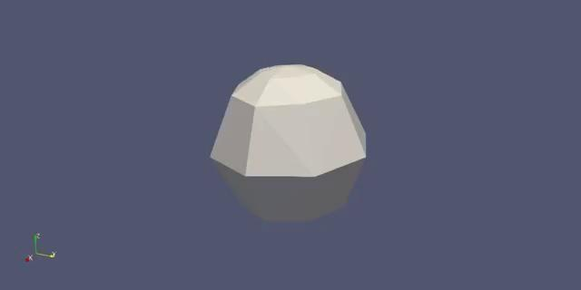
Refinement Examples:
Uniform Domain Refinement

Slide 13

Refinement Examples:
Selective Refinement

Slide 14
Refinement Examples:
Local Refinement

Slide 15
Discussion and Future Work
The tool successfully constructs and refines volumetric spherical shell domains.
It can be used for both Finite Element Analysis and Isogeometric Analysis.
Future work:
There are opportunities to parallelise:
Evaluating points of a spline is computationally independent.
Functionality can be extended for lower dimensional entities:
Include global and local refinement for curves and surfaces.
S-Spline refinement is “meshy”:
Wrapper functions can be implemented to streamline the process.
S-Spline local refinement can be more robust:
Only Class 1 refinement was implemented.
More algorithms for T-Spline refinement can be implemented.

Slide 16
Bibliography
Vance, S. D. et al. (2018) ‘Geophysical Investigations of Habitability in Ice-Covered Ocean Worlds’, Journal of Geophysical Research: Planets, 123(1), pp. 180–205. doi: 10.1002/2017JE005341.
Sederberg, T. W. and Zheng, J. (2001) ‘T-splines and T-NURCCs’.
Li, X. and Sederberg, T. W. (2019) ‘S-splines: A simple surface solution for IGA and CAD’, Computer Methods in Applied Mechanics and Engineering. Elsevier B.V., 350, pp. 664–678. doi: 10.1016/j.cma.2019.03.035.
Hughes, T. J. R., Cottrell, J. A. and Bazilevs, Y. (2009) Isogeomtric Anlysis: Toward Integration of CAD and FEA.
Piegl, L. and Tiller, W. (1997) Monographs in Visual Communication, The NURBS Book. Springer Series.

Slide 17
Thank you!
:)

